Slide 1
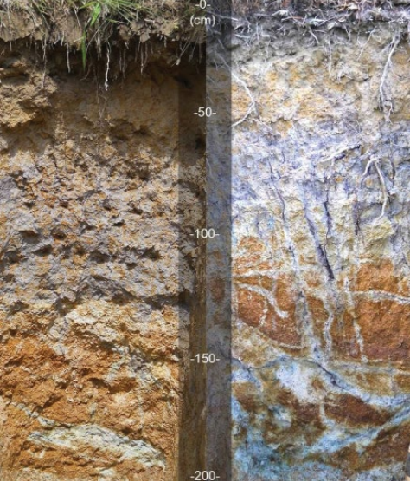
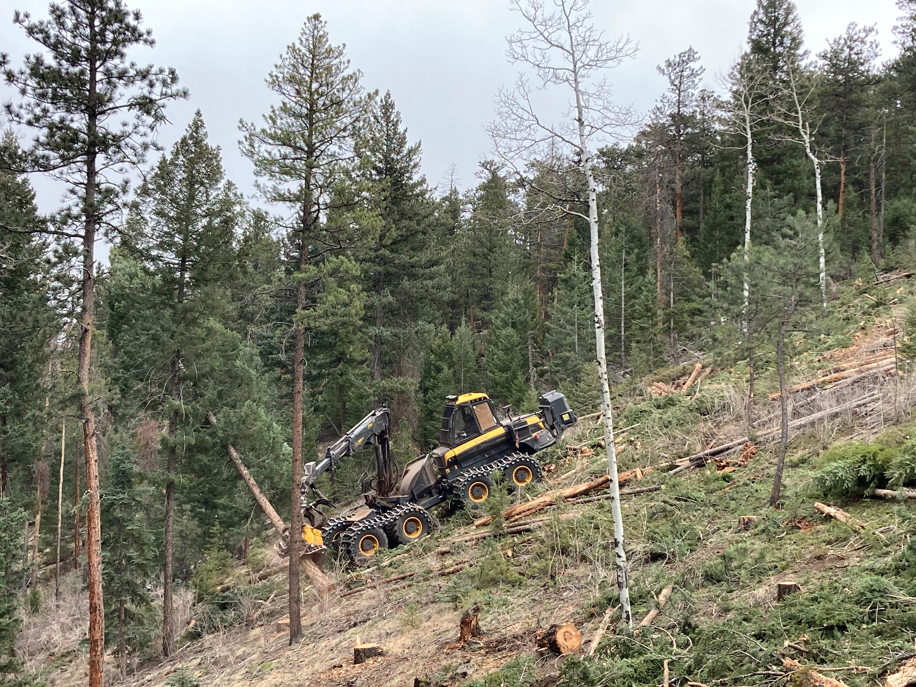

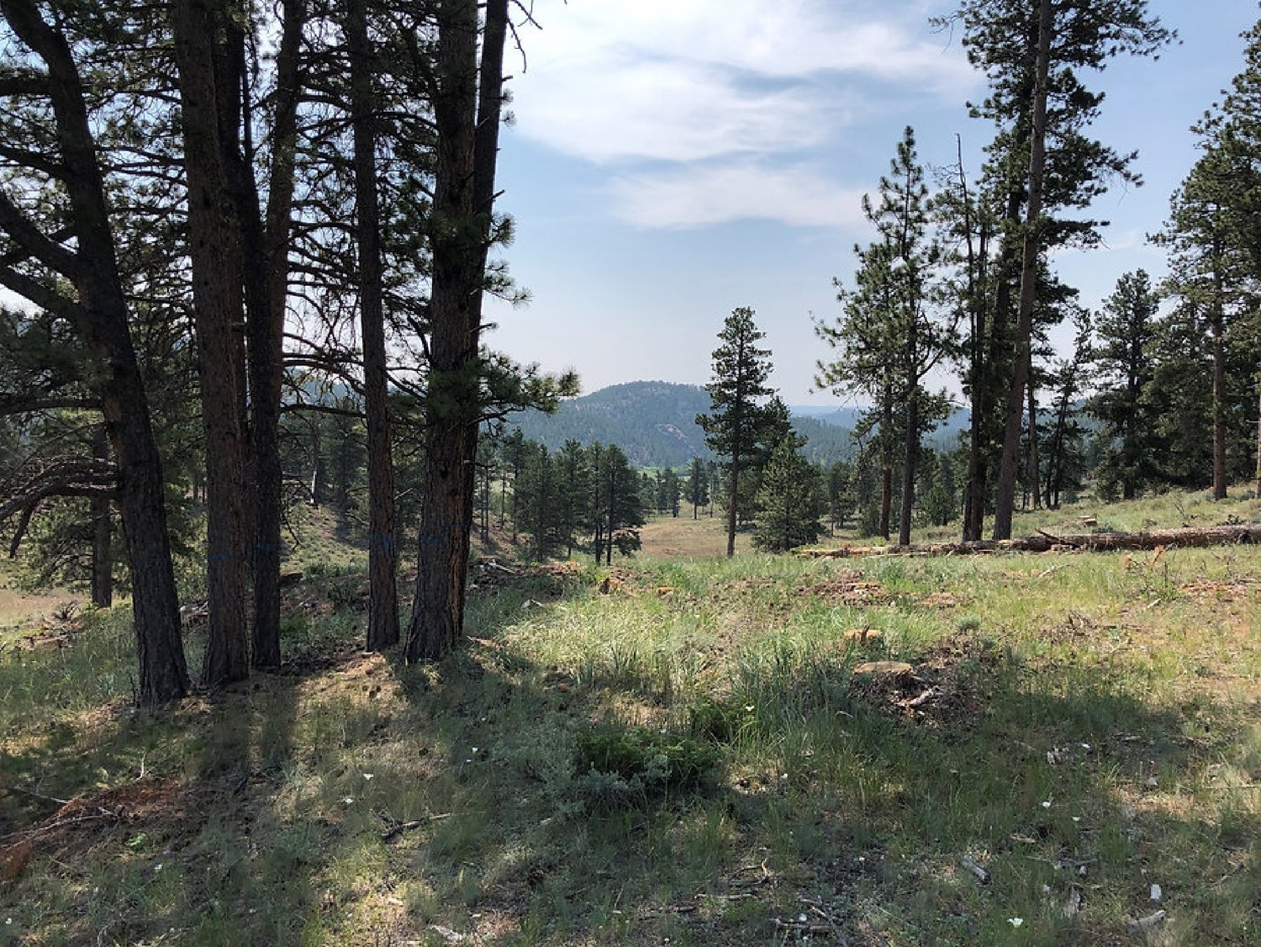
Module 5: Conservation practices commonly used in forestland and their soil health implications

Slide 2
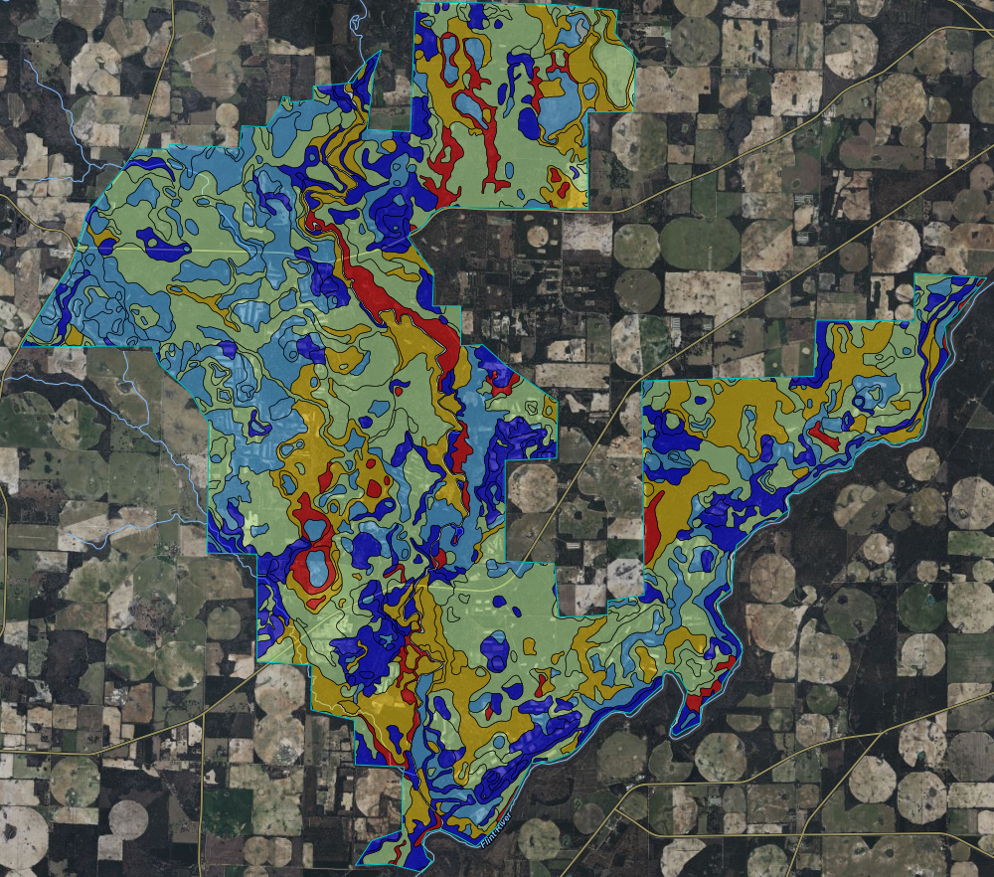
Module 5: A Road Map
What we will “uncover” through this module
  Developing your soil health baseline.
  What practice purposes facilitate soil health?
  What conservation practices in silvicultural settings can been used, which could be used more?
Notes:
Module Outline
This module will touch upon yesterday’s in-depth conversation about the principles to soil health and resource concerns, to several (but definitely not all) of the Conservation Practices that facilitate improving, maintaining, or enhancing factors associated with soil health. The goal is to engage the audience with their lived experiences, knowledge without context to a personal an important way to them, is just knowledge that can be easily discarded or worse, disregarded. Be kind, be provocative, be in the moment with them, and the content we want to “uncover”.

Slide 3
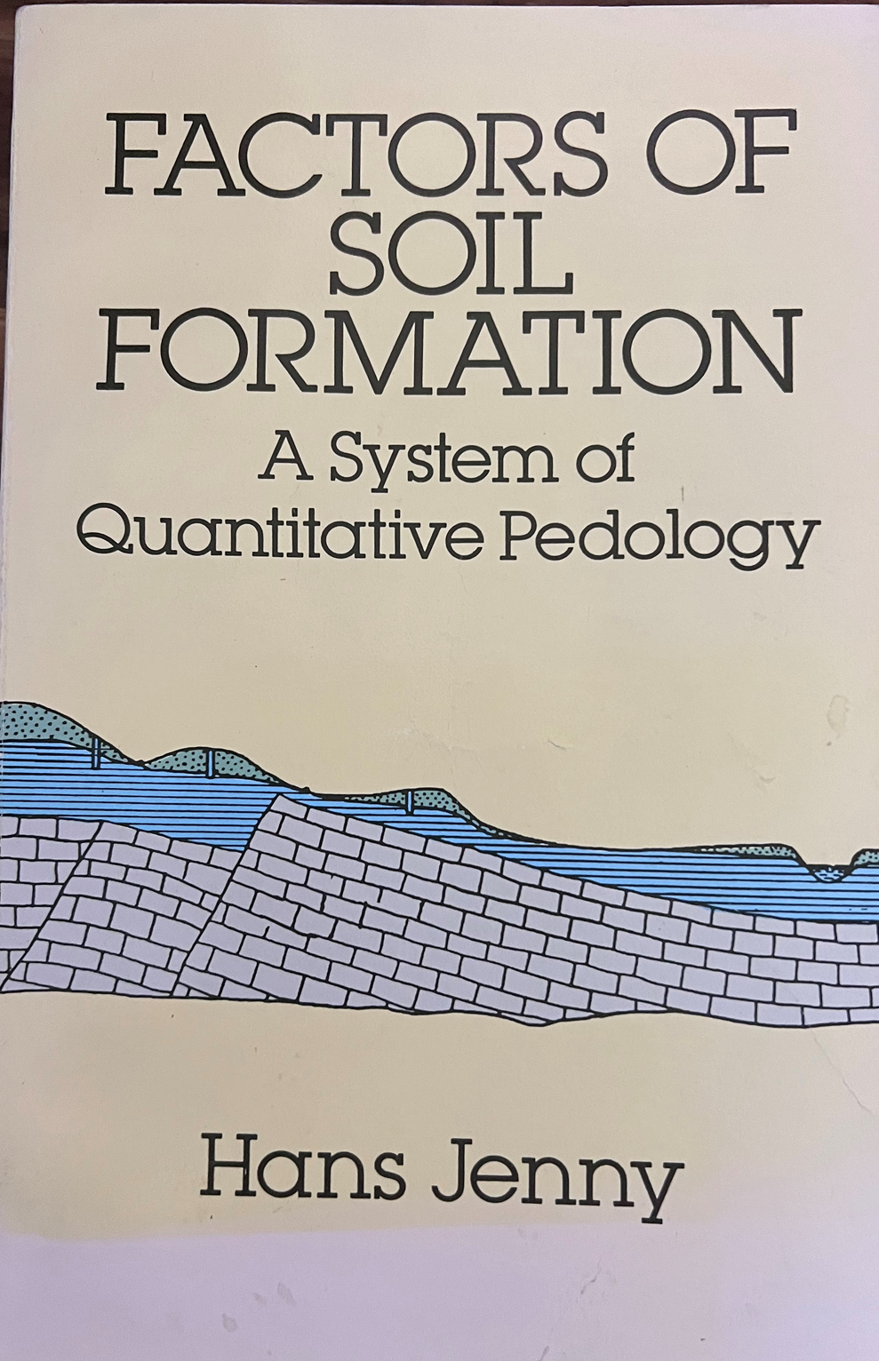
Principles to Purposes
Understand the principles of soil health will lead to determining the purposes in each Conservation Practice
  Factors of Soil Formation
    Hans Jenny (1899 – 1992)
Climate (cl’)
Organisms (o’)
Topography (r’)
Parent material (p)
Time (t)
Independent variables or soil-forming factors
Notes:
Principles to Purposes (slide 1)
The basis of understanding what happens in soils starts with the soil pedon. Set your program, and students up with the questions, “Where is it”?, “How did it get to be this or that way”?, and “Where can it go based on sound (or unsound) management and practices”?
Hans Jenny (1899 – 1992) Swiss soil scientist that pioneered the quantitative study of soil development. (father of pedology)
He very elegantly developed the idea that all soils are the result of processes that have differential outcomes determined by individual top down and bottom-up processes such as climate and parent material, as well as independent in-situ variables like organisms, biogeochemical processes, all mediated by modifiers such as topography, time, and of course human interactions.

Slide 4

Principles to Purposes
Understand the principles of soil health will lead to determining the purposes in each Conservation Practice
  Factors of Soil Formation
    Hans Jenny (1899 – 1992)
  $$S= f (cl^{′}, o’ , r’ , p, t, …)$$
Notes:
Principles to Purposes (slide 2)
When Jenny further refined these ideas, it leads to a highly differentiable framework known colloquially as “the factors of soil formation”. This is an all-encompassing idea, because by understanding the constituent components of this function, one can begin to understand perhaps even anticipate how unstainable management and resource management will impact soils of any given site.

Slide 5
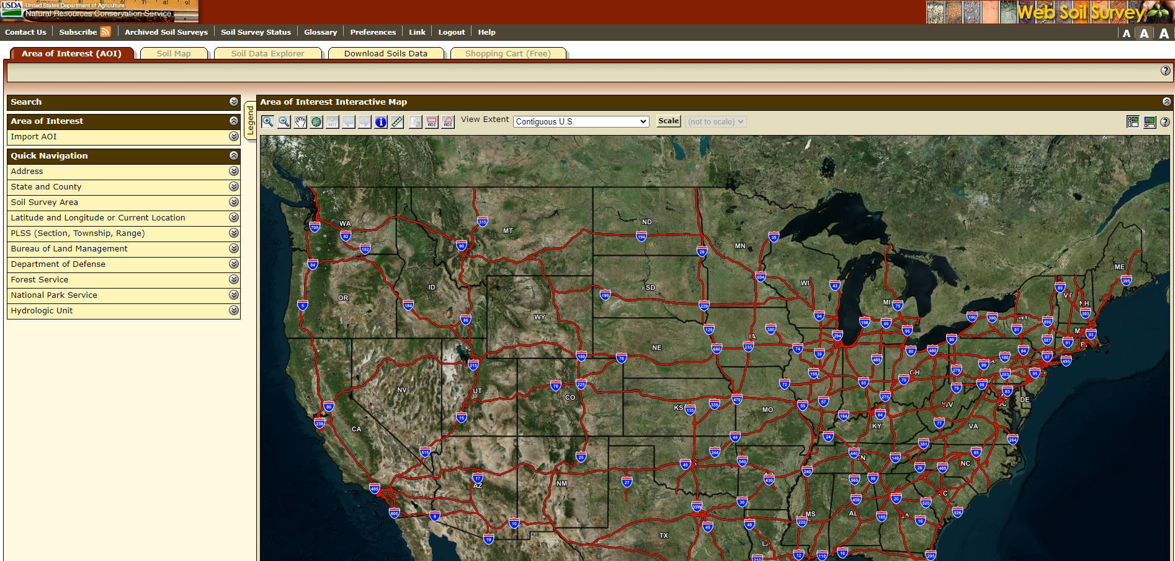
Principles to Purposes
What information can we use to inform our understanding of soil properties before we ever think about using the Forest In-field Soil Health Assessment?
  Web Soil Survey
Notes:
Principles to Purposes (slide 3)
But don’t take just one person’s view of it, there are lots of great peer reviewed sources out there!

Slide 6
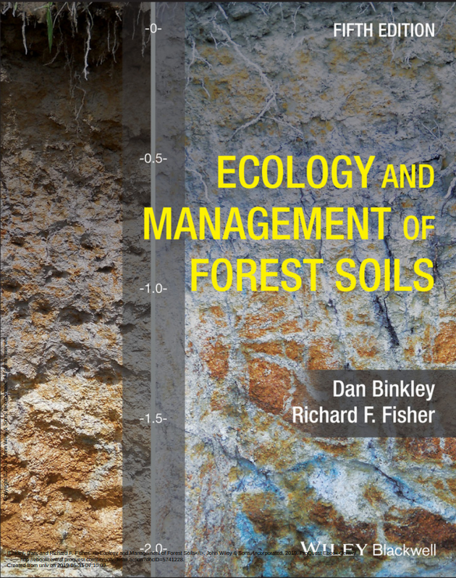
Principles to Purposes
What information can we use to inform our understanding of soil properties before we ever think about using the Forest In-field Soil Health Assessment?
  Text Books
Surface - Available Water Capacity
Notes:
Principles to Purposes (slide 4)
But don’t take just one person’s view of it, there are lots of great peer reviewed sources out there!

Slide 7
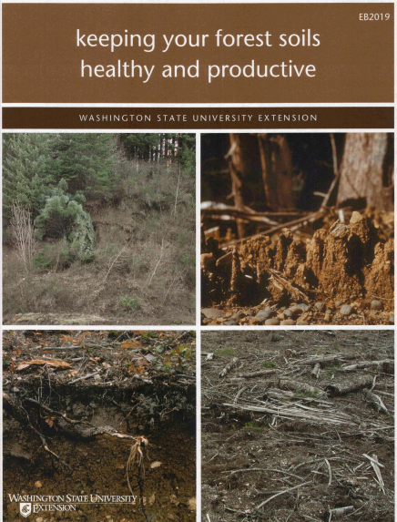
Principles to Purposes
What information can we use to inform our understanding of soil properties before we ever think about using the Forest In-field Soil Health Assessment?
  University Extension
Surface - Available Water Capacity
Notes:
Principles to Purposes (slide 5)
But don’t take just one person’s view of it, there are lots of great peer reviewed sources out there!

Slide 8
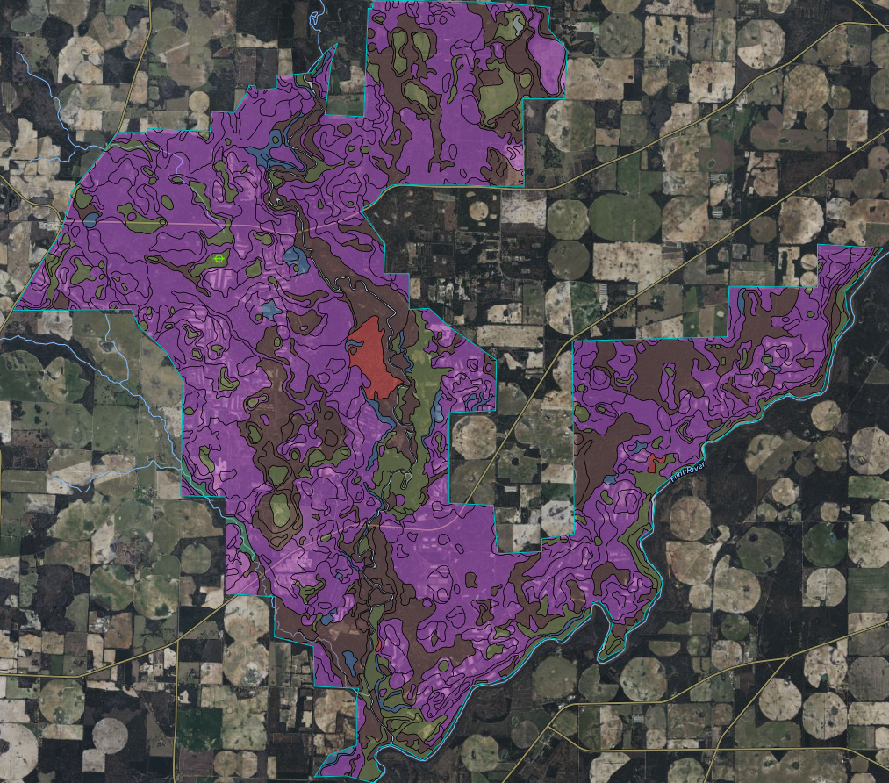
Developing Your Baseline
Loamy Sand
Sand
Loamy Sand
Fine Sandy Loam
0 – 10 cm Bulk Density
10 – 20 cm Bulk Density
Surface Texture
Notes:
Develop Your Baseline (slide 1)
What information can we utilize in say Web Soil Survey could we use to inform strengths and vulnerabilities to soil health. In this image, what do we know about mapped surface soil textures? Image is of longleaf and bottomland hardwoods at the Jones Center at Ichauway, in Newton, Georgia.
Run through the next five slides in a way that draws a basic understanding of locally developed knowledge through in this case SSURGO. The point is, make sure people know that every site is different, and it is our responsibility to know what aspects of soil health translate to the local site in a relevant and impactful way.
In this case we are looking at Soil Surface Texture. How does this physical soil property affect forest soil health?

Slide 9
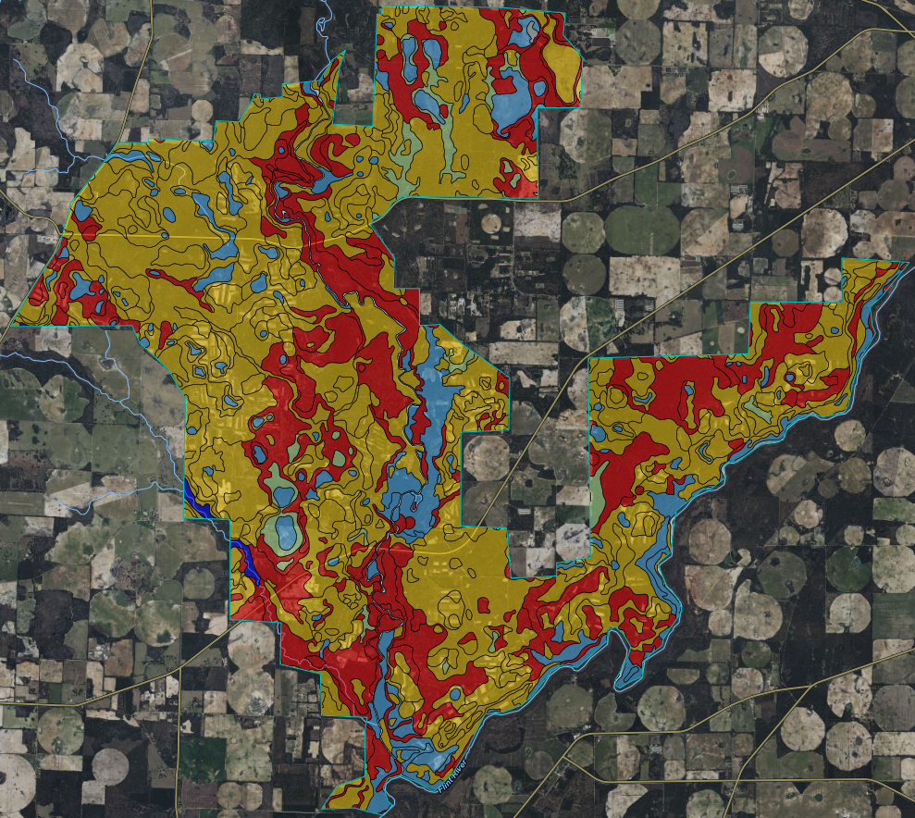
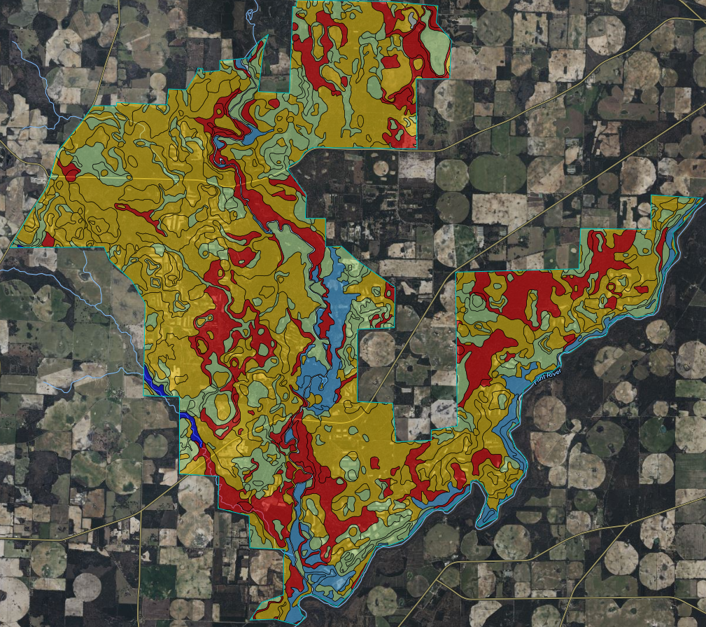
Developing Your Baseline
0 – 10 cm
Organic Matter
10 – 20 cm Organic Matter
Notes:
Develop Your Baseline (slide 2)
Organic Matter - Soil Health Principle (Decrease Soil Disturbance, Maximize Roots, Maximize Soil Cover), and the FIFSHA (Aggregate Stability and Soil Organic Matter– Resource Concerns)
These soils are already relatively low to moderate in soil organic matter. This is important, because it may speak to not what can be done to improve SOM, but rather ensure that management is careful to not reduce it more than it already naturally is.

Slide 10
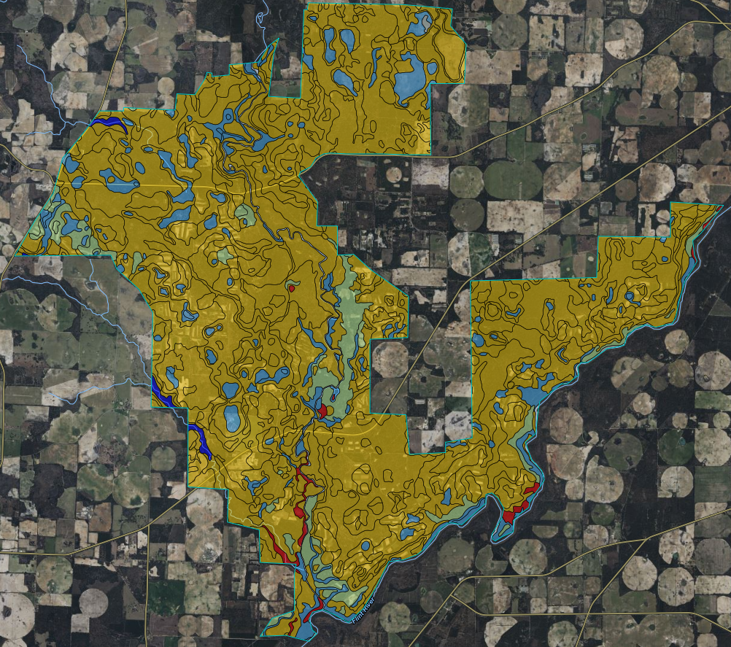
Developing Your Baseline
Surface - Available Water Capacity
5 – 50 in - Available Water Capacity
Notes:
Develop Your Baseline (slide 3)
Available Water Capacity to Soil Health Principle (Decrease Soil Disturbance, Maximize Plant Roots), and the FIFSHA (Soil Organic Matter Depletion, Soil Aggregate – Resource Concern)
Soil Water Surface available water is moderately low, likely due to deep sandy based soils, and low water holding capacity in upper soil horizons. As depth in soil horizons increase, water holding capacity increases significantly, this has implications for a multitude of soil health principles, and we want to make sure that again, what are the strengths and vulnerabilities of these soils to management, or if “improvements” through management can or should be made.

Slide 11
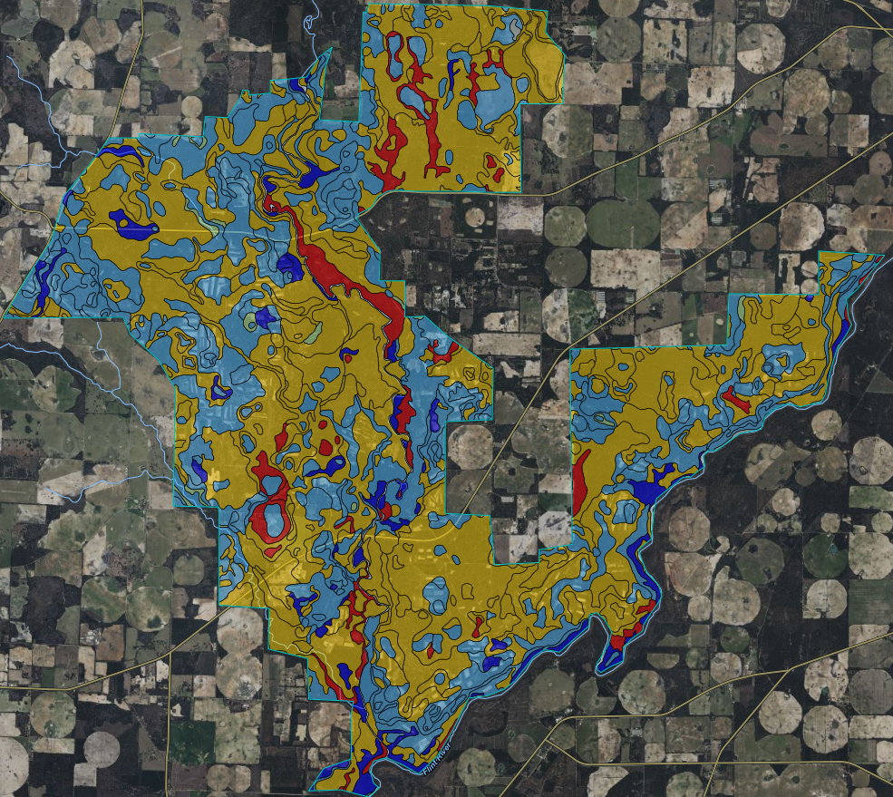
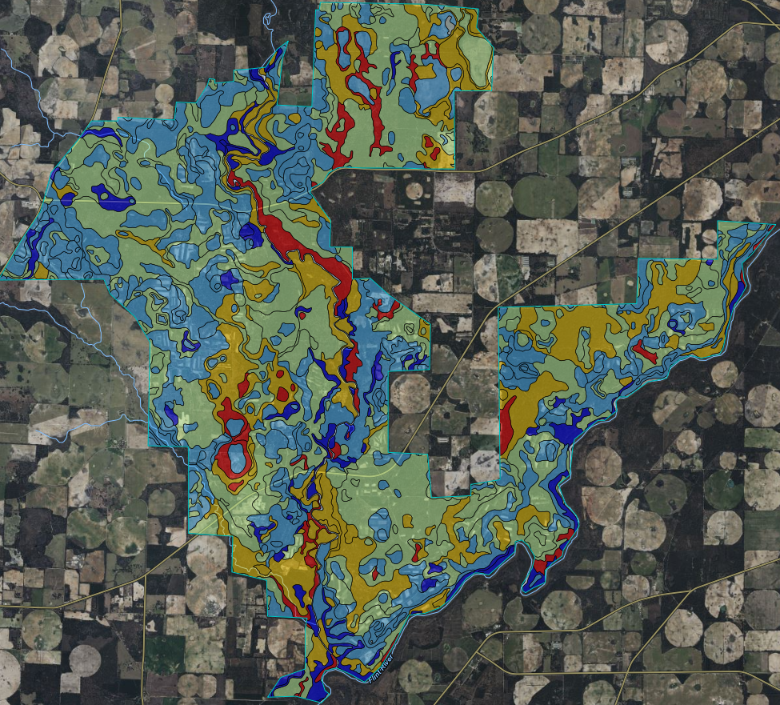
Developing Your Baseline
0 – 50 cm Water Storage
0 – 150 cm Water Storage
Notes:
Develop Your Baseline (slide 4)
Water Storage to Soil Health Principle (Decrease Soil Disturbance, Maximize Soil Cover, Maximize Plant Roots), and the FIFSHA (Compaction, Soil Organic Matter, Soil Aggregate – Resource Concern)
Water storage is another consideration that lends itself to soil health principle of maximizing biodiversity, are plant community assemblages and their respective above and below ground resource allocation adapted to physical soil characteristics? Does large scale diversity based on the these, soil map units promote one size fits all approach to management? The answer is clearly “no”

Slide 12
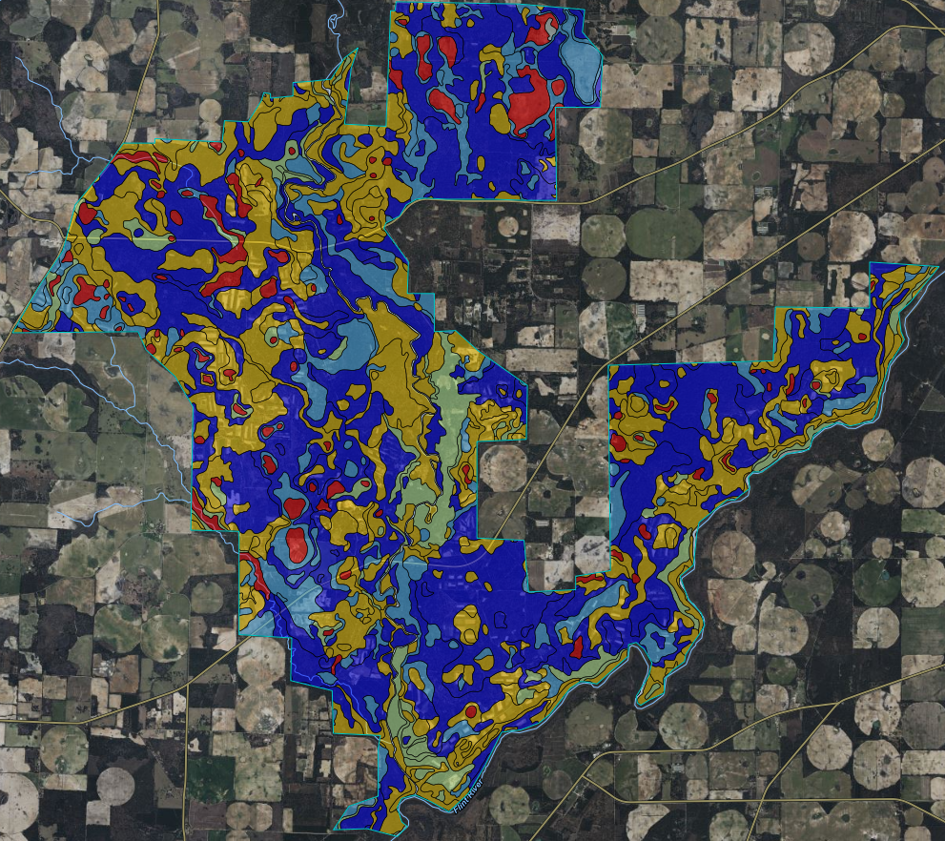
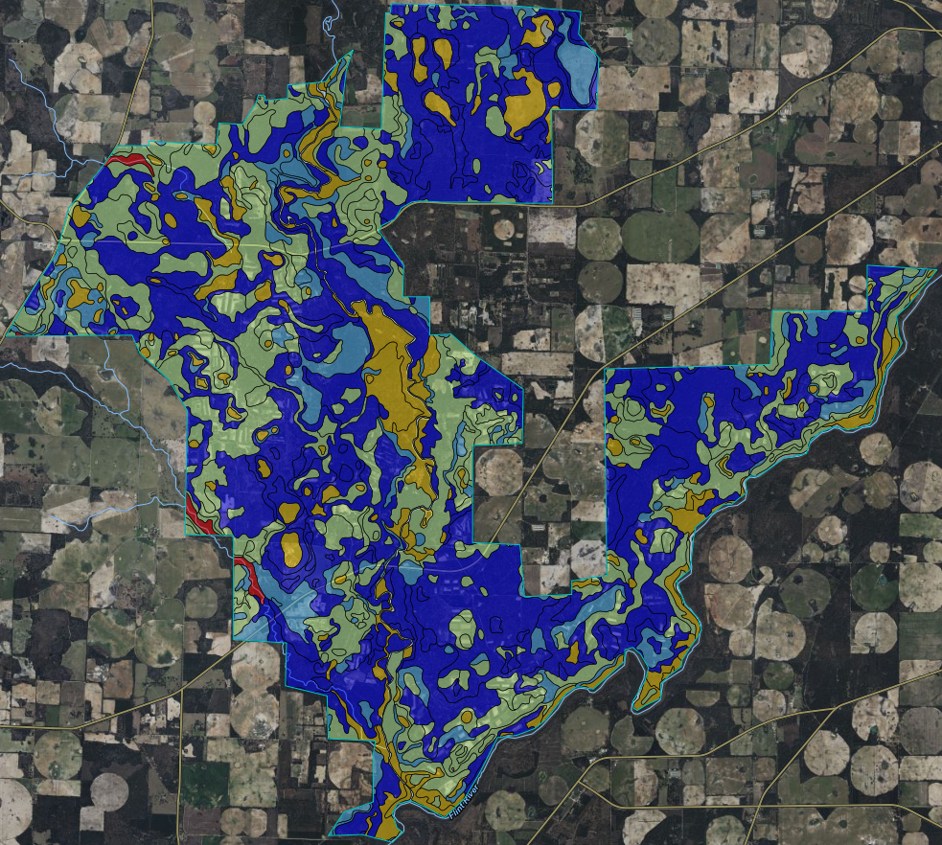
Developing Your Baseline
0 – 10 cm Bulk Density
10 – 20 cm Bulk Density
Notes:
Develop Your Baseline (slide 5)
Bulk Density to Soil Health Principle (Decrease Soil Disturbance, Maximize Soil Cover, Maximize Plant Roots), and the FIFSHA (Compaction, Soil Organic Matter, Soil Aggregate – Resource Concern)
We know that given the sandy based soil textures that existing soil bulk densities are low, this may indicate that the risk of soil compaction is low, but it also can mean that what may be already a low bulk density can turn into a significant concern if management is not implemented appropriately. Ask the right questions! Seek to understand how the local practices address principles of soil health as a function of soil disturbance, or in the assessment as a function of compaction.

Slide 13
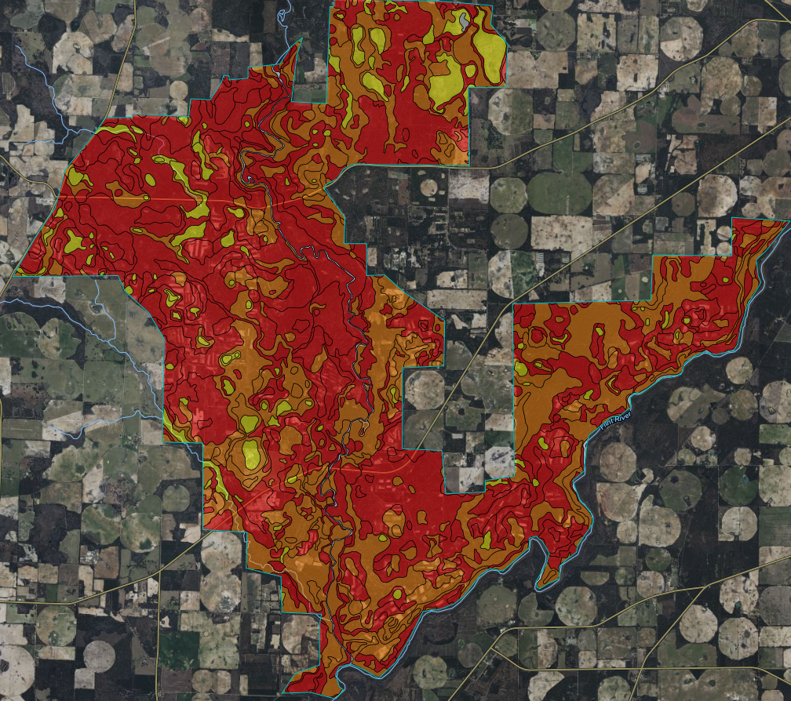
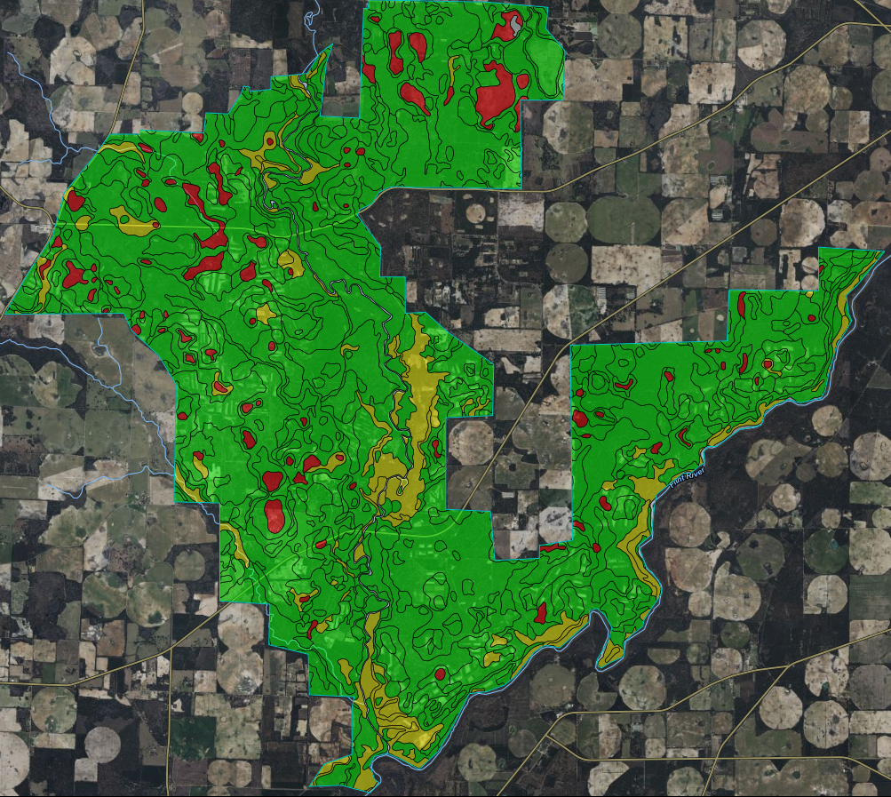
Developing Your Baseline
Organic Matter Depletion
Compaction Susceptibility
Notes:
Develop Your Baseline (slide 6)
Soil Interpretations for Organic Matter Depletion, and Susceptibility to Compaction.
The SSURGO interpretations are very helpful here, because it takes the previous slides of the physical soil characteristics, given the climate and biophysical site and interprets the impacts and susceptibility to different types of management. This is important, because again, it points the user to be aware that some principles and resource concerns may not be as much of a concern as others. Focus on what needs to be addressed rather than “checking the box” on all the items.

Slide 14
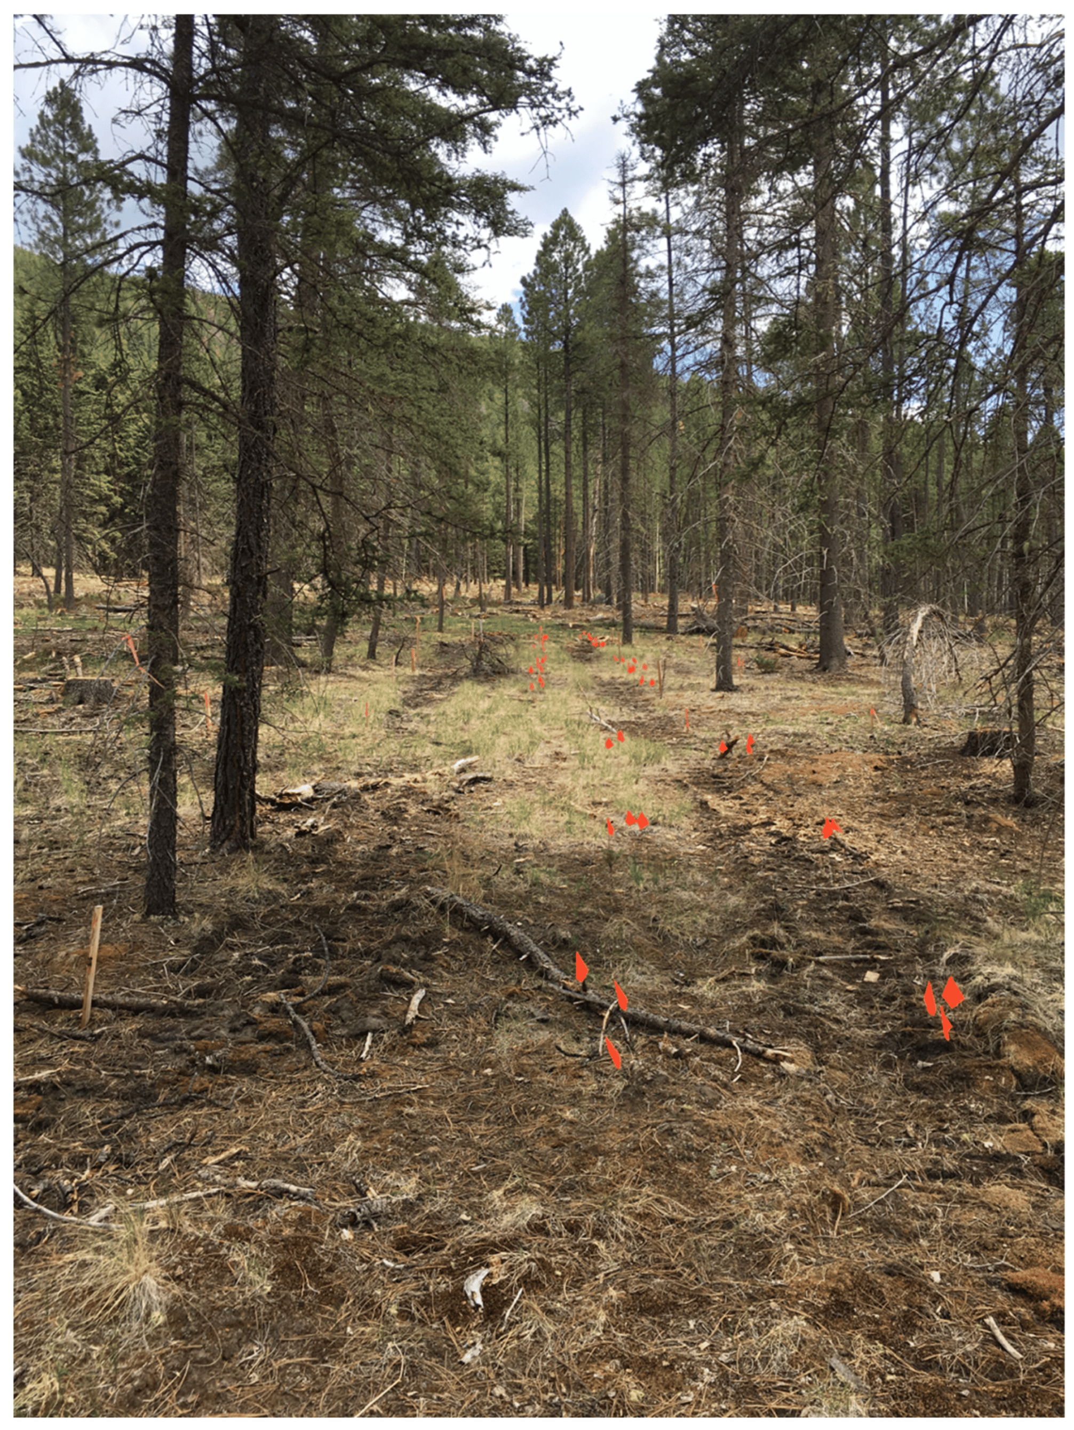
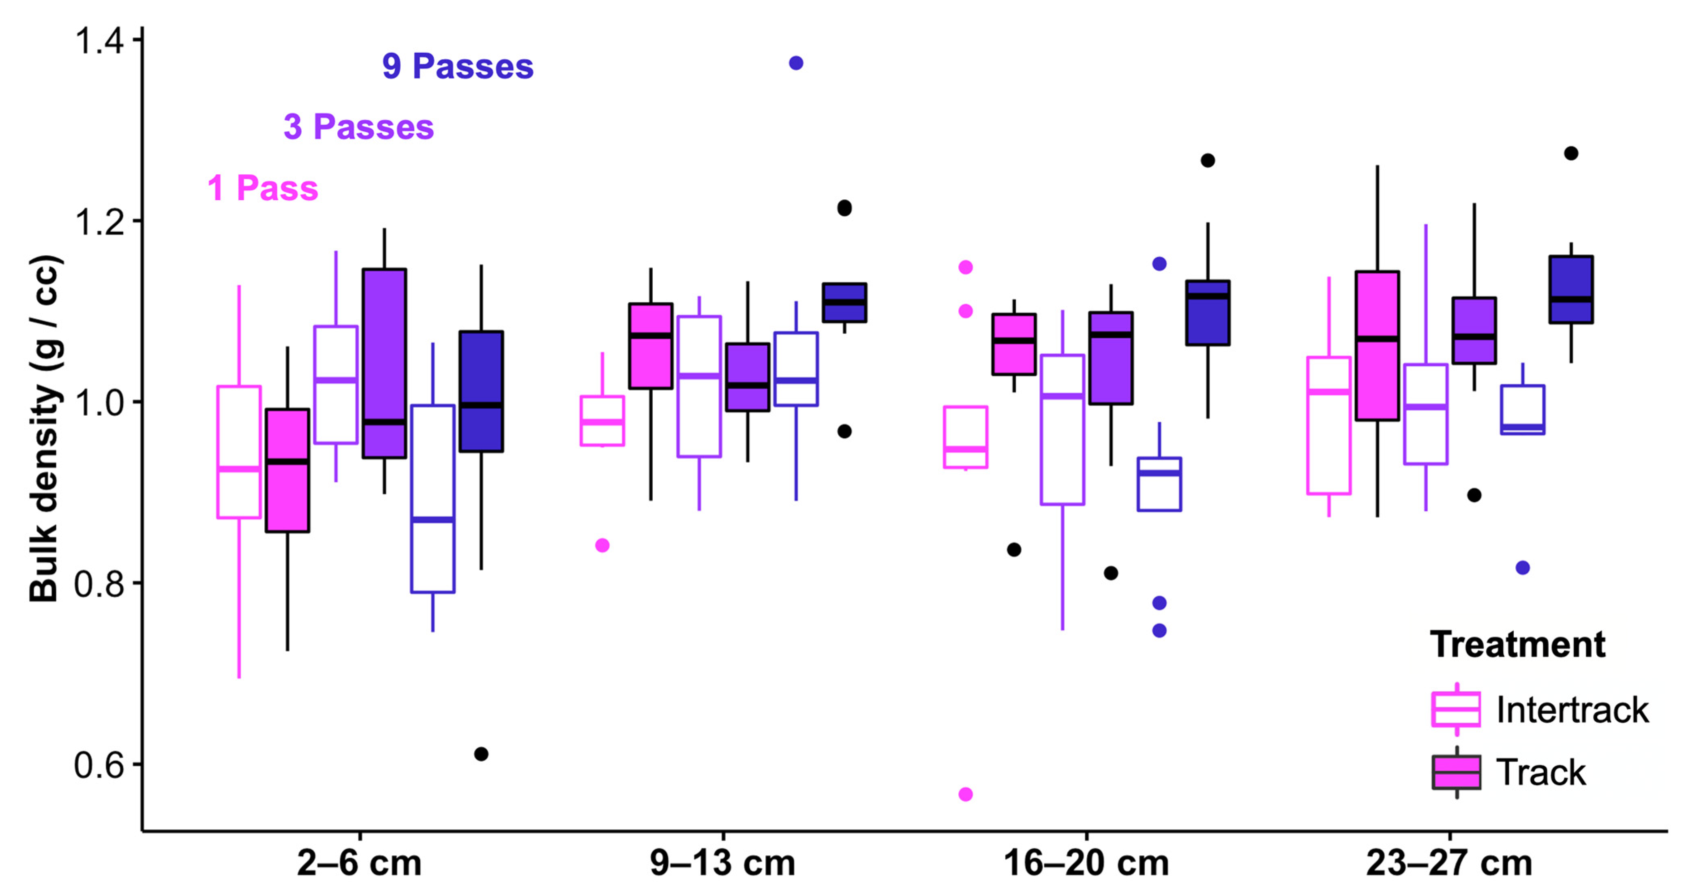
Purposes to Practices
Minimize Disturbance
Access Control (472), Conservation Cover (327), Fence (382), Forest Trails and Landings (655), Heavy Use Area Protection (561), Mulching (484), Prescribed Grazing (528),Road/Trail/Landing Closure (654), Tree/Shrub Site Preparation (490).
Gibson et al 2023
Gibson et al 2023
Notes:
Minimizing Disturbance – Reducing Compaction (slide 1)
Minimizing disturbance is a critical piece to the overall soil health strategy. Compaction through the increase of soil bulk density is consistent and persists throughout the soil profile as vehicle traffic increases. Notice that single passes don’t look too much different at the surface horizon (why is that maybe?) but even 9+cm down there can be real and important differences. So it may not always be obvious by looking at the surface horizons! How does this also affect Aggregate Stability? Soil Habitat?
Citation: Gibson, Kara S., Deborah A. Neher, Nancy C. Johnson, Robert R. Parmenter, and Anita J. Antoninka. 2023. "Heavy Logging Machinery Impacts Soil Physical Properties More than Nematode Communities" Forests 14, no. 6: 1205.

Slide 15
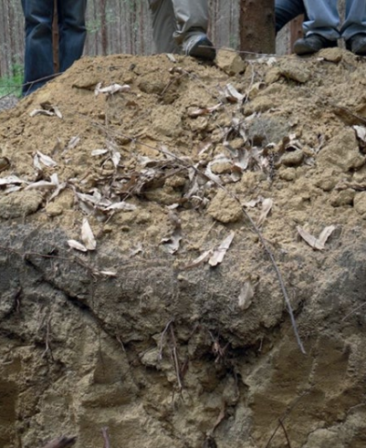
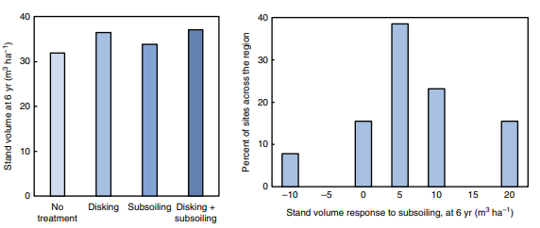
Purposes to Practices
Minimize Disturbance
Some practices can have an opposite effect on above and below ground soil health properties.
Binkley and Fisher 2020
Notes:
Minimizing Disturbance – Reducing Compaction (slide 2)
A practice that is used for initial planting (Tree/Shrub Site Preparation - 490), but also can be applied in post-logging (Road/Trail/Landing Closure - 654) is disking and subsoiling. How do these practices affect Aggregate Stability and Soil Habitat? Also, by disking and subsoiling, you can create “dried out soils” that can limit successful regeneration.
In the Binkley and Fisher post 6-year site-prep and yield study of loblolly plantations in North Carolina, demonstrates the variable response of site preparation on volumes. The graph on the left shows the relative differences between site preparation, where simple disking may be all that is necessary in achieving volume results. The graph on the right shows that in the case of post planting volumes, site preparation can have no response to a negative 10 cubic meters response across about 20% of sites in the study region. About 60% of the sites had no more than 5-10 cubic meters of volume, with only about 15% of the sites showing a sizable increase of 20 cubic meters of volume.
This suggests that, judicious use of site preparation is necessary in working with clients and partners, planners can ask if “the juice is worth the squeeze” from an inputs (energy, labor, equipment) to increased biomass output (volume per acre). Another consideration is from a regulatory perspective, can site preparation activities affect wildlife and/or clean water rules. Something to consider. This can be a “spicy” subject, but the point is, if you know your soils, and the physical properties that govern above and below ground soil health properties, using the right practice in the right place for the right purpose is just fine!

Slide 16
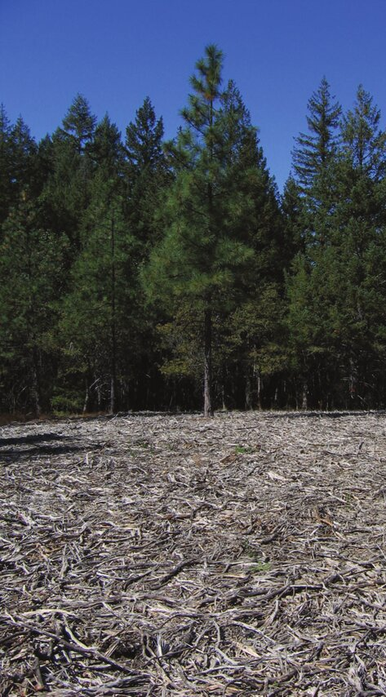
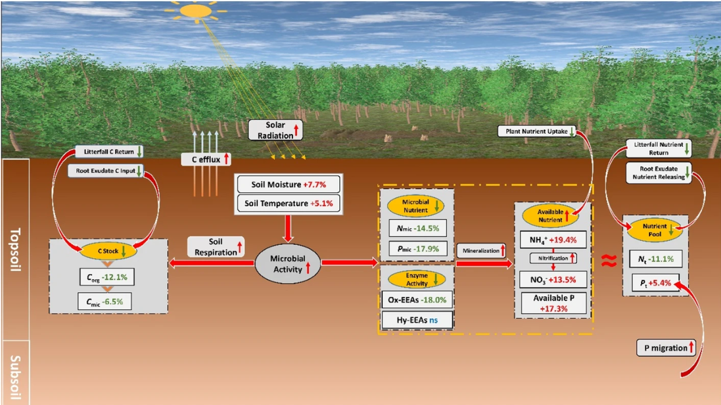
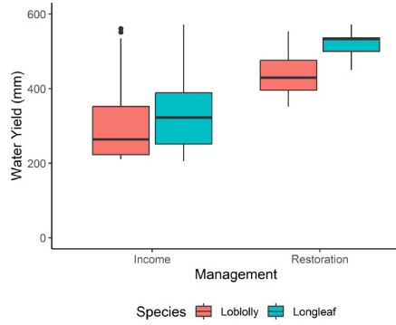
Purposes to Practices
Maximize Soil Cover
Brush Management (314), Fence (382), Fuel Break (383), Forest Stand Improvement (666), Critical Area Planting (342), Rangeland Seeding, Mulching (484), Tree/Shrub Establishment (612), Woody Residue Treatment (384).
Chambers et al 2024
Multi-storied forests
Small meadows
Logged sites
Younger regeneration
Tong et al 2024
Kane et al 2009
Notes:
Maximizing Soil Cover (slide 1)
Not all soil cover is the same, the goal should not just be cover. Forest canopy, litter, and herbaceous cover work in concert, as a portfolio of long-term resilient soil cover (image on the left), which conservation practices would we put in each of these boxes?. Where managing for full site occupancy by trees can affect the surface hydrology, not allowing understory plants to establish or grow (center graph), or in many instances where heavy litter (through mastication) can create a barrier for both tree seedlings and herbaceous cover establishment (image on the right).
Citation:
Left side image: Tong, R., Ji, B., Wang, G.G. et al. Canopy gap impacts on soil organic carbon and nutrient dynamic: a meta-analysis. Annals of Forest Science 81, 12 (2024)
Right side image: Kane, Jeffrey & Varner, J. & Knapp, Eric. (2009). Novel fuelbed characteristics associated with mechanical mastication treatments in northern California and south-western Oregon, USA. International Journal of Wildland Fire. 18. 686-697.
Graph: Chambers J. English, Seth E. Younger, Jeffery B. Cannon, Steven T. Brantley, Daniel Markewitz, Puneet Dwivedi, Forest management for water yield: Assessing the barriers and impacts of privately-owned open pine woodlands in the Southeastern United States, Trees, Forests and People, Volume 17, 2024, 100600,

Slide 17
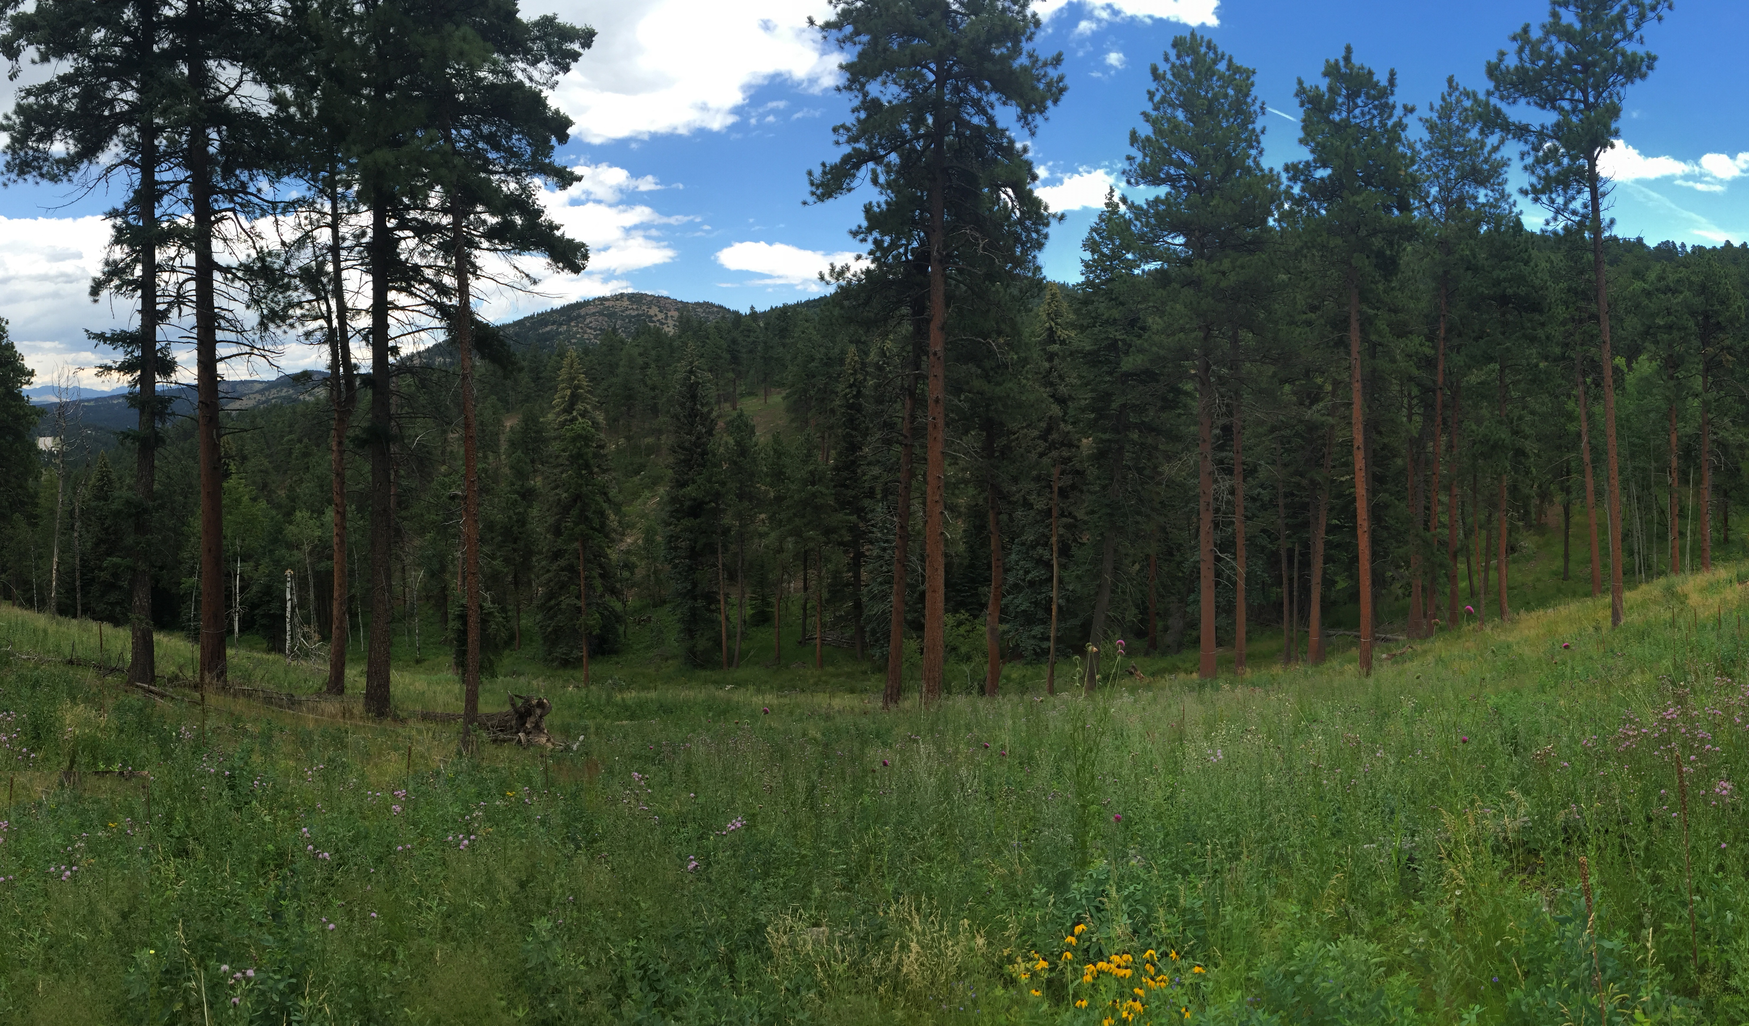
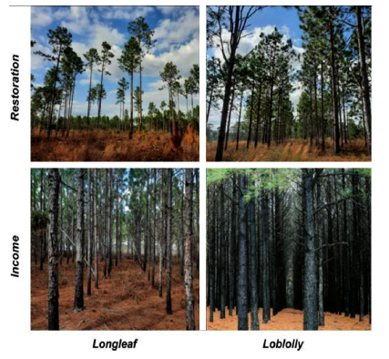
Purposes to Practices
“…forest biodiversity is driven by environmental variables that are under the direct control of the actual silvicultural management. Thus, forest management has an important responsibility and, at the same time, a huge opportunity to preserve (or even improve) the biodiversity of forests."
Maximize Biodiversity
Forest Stand Improvement (666), Herbaceous Weed Treatment (315), Prescribed Burning (338), Restoration of Rare and Declining Natural Habitats (643), Tree/Shrub Establishment (612)….
Feinstein 2014
Chambers et al 2024
Tinya et al 2021
Notes:
Maximizing Biodiversity (slide 1)
Biodiversity, what more can you say. Get the ecology right. Use or develop your own ESDs. Understand the importance of resource allocation amongst plant functional traits and groups.
Citations:
Left photo: Jonas Feinstein, personal photo of West Ranch – Phase 1
Middle photo: Chambers J. English, Seth E. Younger, Jeffery B. Cannon, Steven T. Brantley, Daniel Markewitz, Puneet Dwivedi, Forest management for water yield: Assessing the barriers and impacts of privately-owned open pine woodlands in the Southeastern United States, Trees, Forests and People, Volume 17, 2024, 100600
Quotation on right panel: Flóra Tinya, Bence Kovács, András Bidló, Bálint Dima, Ildikó Király, Gergely Kutszegi, Ferenc Lakatos, Zsuzsa Mag, Sára Márialigeti, Juri Nascimbene, Ferenc Samu, Irén Siller, Győző Szél, Péter Ódor,
Environmental drivers of forest biodiversity in temperate mixed forests – A multi-taxon approach, Science of The Total Environment, Volume 795, 2021,

Slide 18
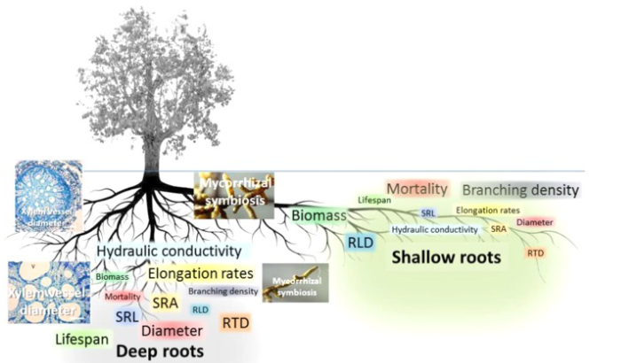
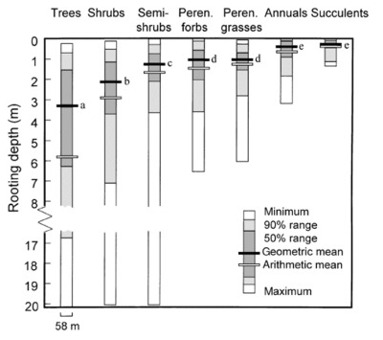
Purposes to Practices
Maximize Plant Roots?
  Forest Stand Improvement (666), Tree/Shrub Establishment (612), Tree/Shrub Site Preparation (490), Herbaceous Weed Treatment (315), Prescribed Burning (338).
Germon et al 2020
Notes:
Maximize Tree Roots (slide 1)
The special below ground niches of different functional plant groups, and their respective mycorrhizal relationships, plant and fungal exudates, biomes, and the like lead to important below grown diversity! (Image on the left) above and below ground resource allocation amongst different functional groups of plants. And not just roots of one functional group, but many.(graph on the right)
Citation:
Amandine Germon, Jean-Paul Laclau, Agnès Robin, Christophe Jourdan, Tamm Review: Deep fine roots in forest ecosystems: Why dig deeper?, Forest Ecology and Management, Volume 466, 2020, 118135,

Slide 19
Select Overview of Soil Health Conservation Practices on Forest Landuses
Conservation Practice | Practice Code | Brief Glance at Select Benefits
Access Control | 472 | The temporary or permanent exclusion of animals, people, vehicles, and equipment from an area to reduce compaction and desirable plant communities
Critical Area Planting | 342 | Establishing permanent vegetation on sites that have, or are expected to have, high erosion rates, and on sites that have physical, chemical, or biological conditions that prevent the establishment of vegetation with normal seeding/planting practices.
Forest Stand Improvement | 666 | Maintain or improve forest carbon stocks • Maintain or improve forest health and productivity • Maintain or improve forest structure and composition • Reduce forest wildfire hazard
Herbaceous Weed Treatment | 315 | Restore or release native or desired plant communities for wildlife habitat • Protect soils and control erosion • Reduce fine fuel loads and wildfire hazard • Control pervasive plant species to a desired level of treatment
Mulching* | 484 | Improve the efficiency of moisture management • Reduce concentrated flow erosion • Reduce sheet, rill, and wind erosion • Improve plant productivity and health • Maintain or increase organic matter content
Notes:
Okay, remember back to earlier modules where we explored Resource Concerns associated with Forest Soil Health? Well, this is where the rubber hits the road, and we want to explore a few key practices that aim at improving, maintaining, or enhancing soil health.

Slide 20
Select Overview of Soil Health Conservation Practices on Forest Landuses
Conservation Practice | Practice Code | Brief Glance at Select Benefits
Nutrient Management | 590 | Improve plant health and productivity • Reduce excess nutrients in surface and ground water • Reduce emissions of greenhouse gases (GHG) • Improve or maintain soil organic matter
Prescribed Burning | 338 | Manage undesirable vegetation to improve plant community structure and composition • Manage pests, pathogens, and diseases to reduce plant pressure • Reduce wildfire hazards from biomass accumulation • Improve plant and seed production, quantity, and/or quality • Improve and maintain habitat for soil organisms and enhance soil health
Prescribed Grazing | 528 | Improve or maintain desired species composition, structure and/or vigor of plant communities • Improve or maintain quantity and/or quality of forage for grazing and browsing animals’ health and productivity • Improve or maintain surface and/or subsurface water quality and/or quantity • Improve or maintain riparian and/or watershed function • Reduce soil erosion, and maintain or improve soil health
Notes:
Okay, remember back to earlier modules where we explored Resource Concerns associated with Forest Soil Health? Well, this is where the rubber hits the road, and we want to explore a few key practices that aim at improving, maintaining, or enhancing soil health.

Slide 21
Select Overview of Soil Health Conservation Practices on Forest Landuses
Conservation Practice | Practice Code | Associated Benefits to Soil Health
Restoration of Rare and Declining Natural Communities | 643 | To restore the physical conditions and/or unique plant community on sites that partially support, or once supported, a rare or declining natural community.
Tree/Shrub Establishment | 612 | Maintain or improve desirable plant diversity, productivity, and health by establishing woody plants • Create or improve habitat for desired wildlife species compatible with ecological characteristics of the site • Control erosion • Improve water quality • Reduce excess nutrients and other pollutants in runoff and groundwater Sequester and store carbon • Restore or maintain native plant communities • Provide for beneficial organisms and pollinators
Woody Residue Treatment | 384 | Reduce hazardous fuels • Reduce the risk of harmful insects and disease • Improve access to forage for livestock and wildlife • Improve the soil organic matter • Improve the site for natural or artificial regeneration
Notes:
Okay, remember back to earlier modules where we explored Resource Concerns associated with Forest Soil Health? Well, this is where the rubber hits the road, and we want to explore a few key practices that aim at improving, maintaining, or enhancing soil health.

Slide 22
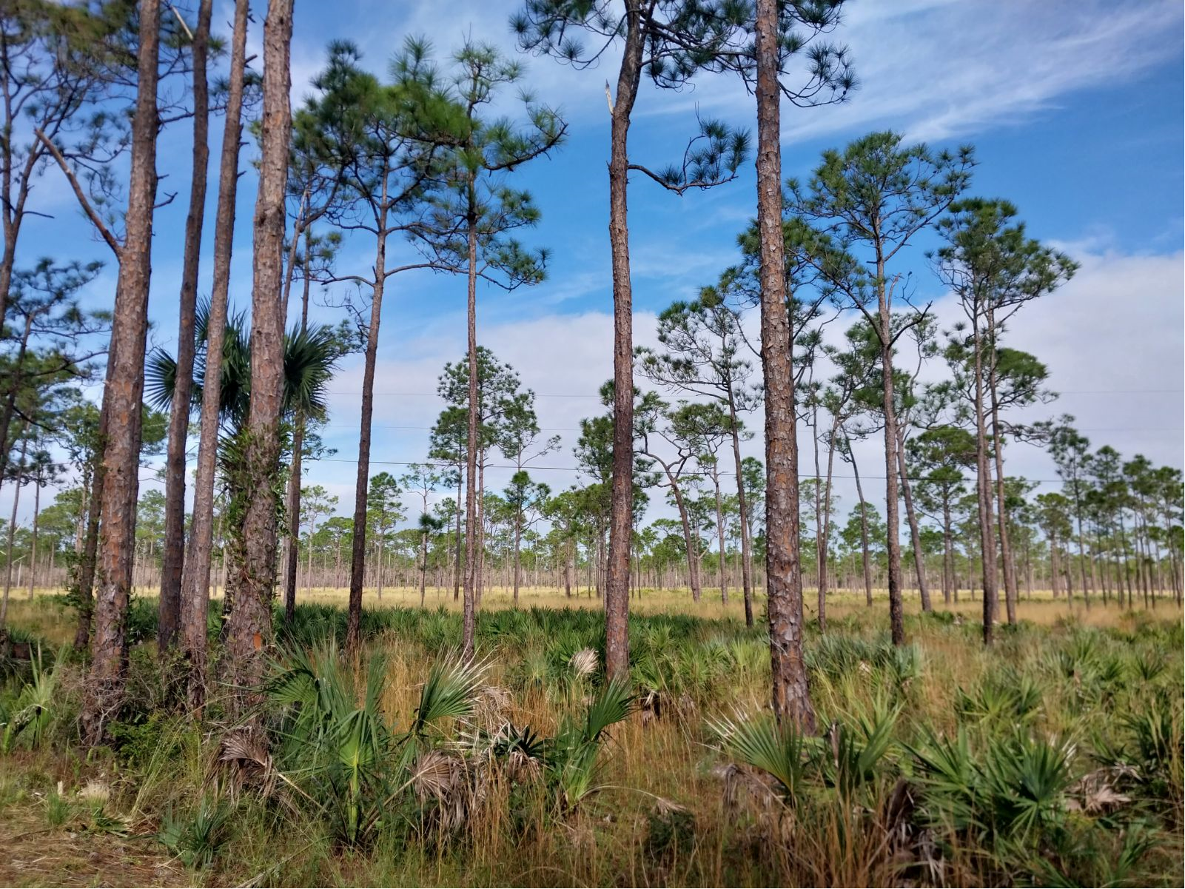
Ask Yourself
“Do I know important physical and chemical properties of the soils I work around?”
  Jenny’s “Factors of Soil Formation”
  Web Soil Survey, SSURGO QT, Extension
  Other sources
“Do I know the Conservation Practices that will create or further degrade forest soil health?”
  Density Management
  Slash Treatment
“Do I know the Conservation Practices that will restore, maintain, or enhance forest soil health?”
Notes:
Put it all together! Close the loop and engage the students to understand that from basic principles, to practice purposes, to practice implementation, that there is a vast and accessible body of knowledge to uncover forest soil health. You don’t need to be the expert, you be the expert of the silviculture of the forests you work in, it’s the exciting opportunity on how you integrate silviculture to soil health that makes this happen!

Slide 23
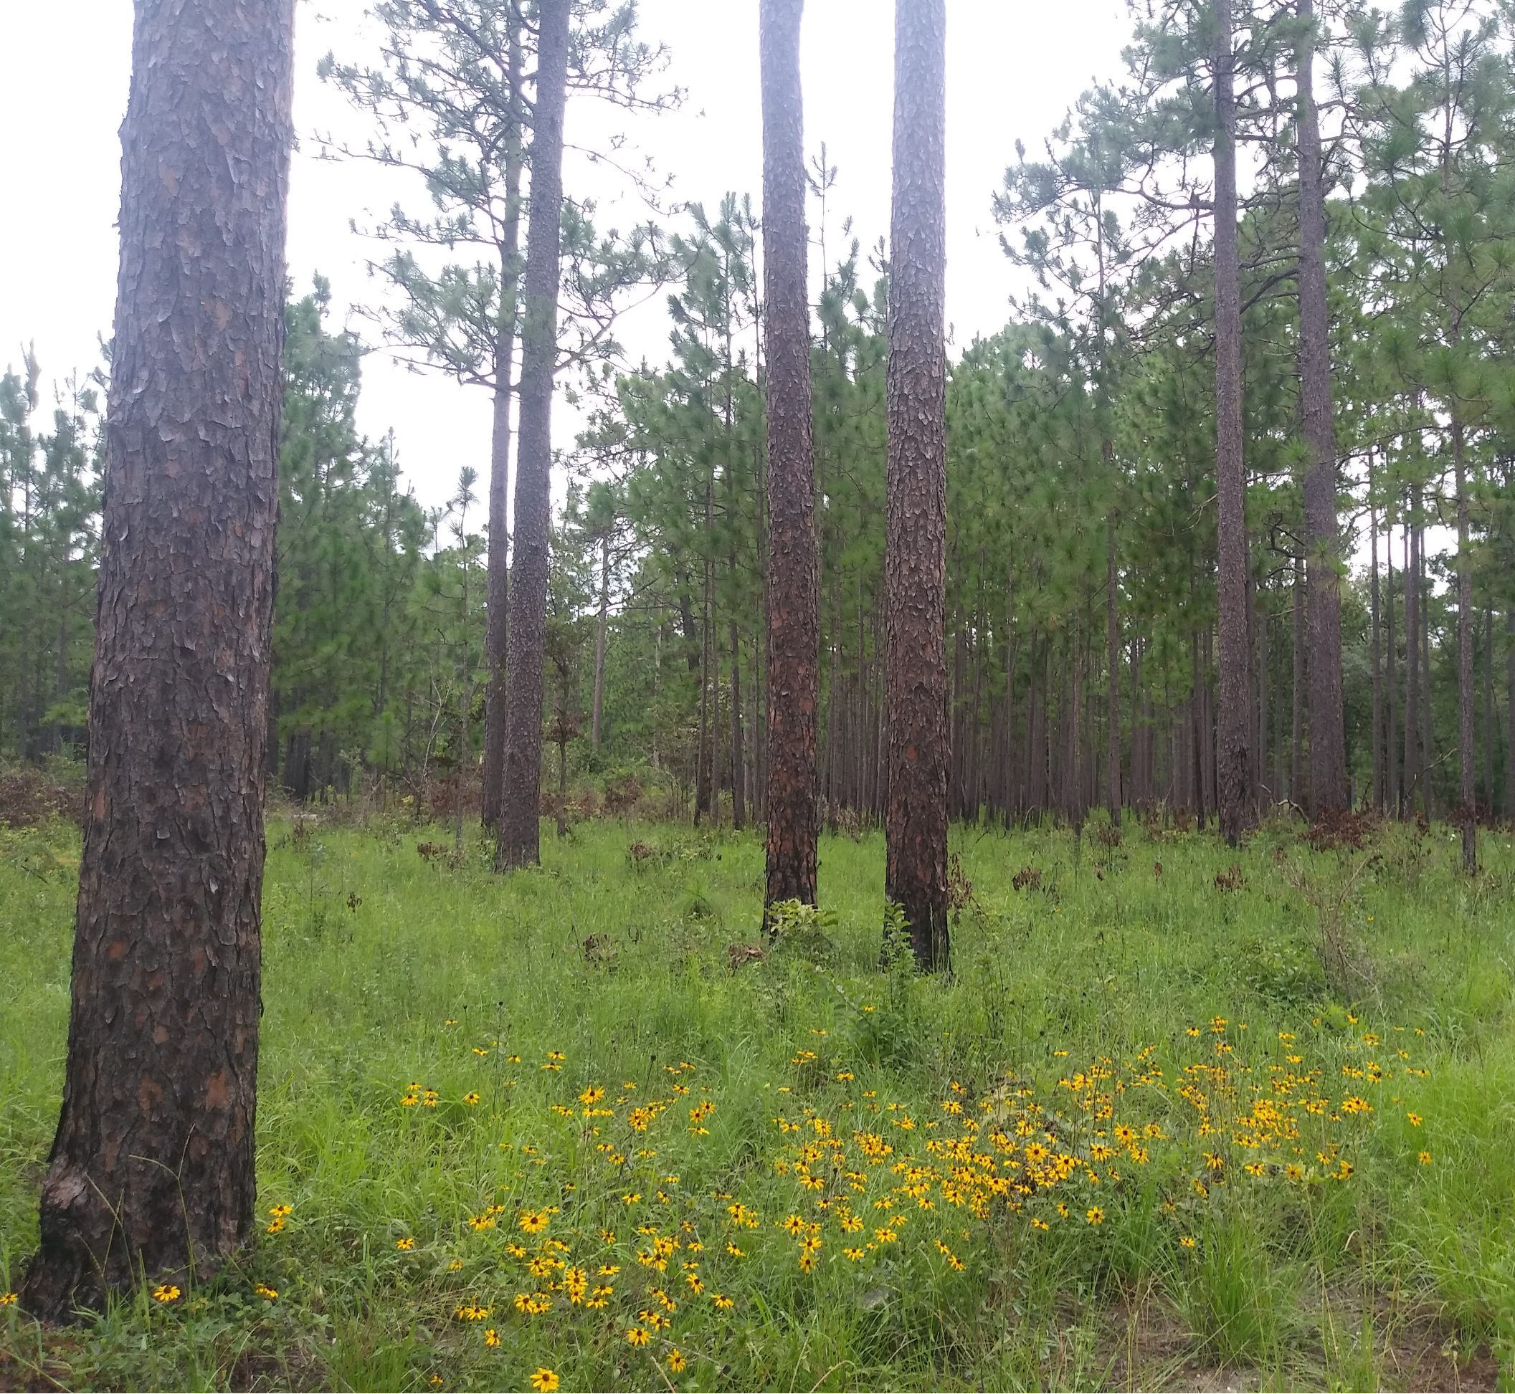
Many Thanks
For more information on Managing Soil Health,
visit us here:
https://www.nrcs.usda.gov/conservation-basics/natural-resource-concerns/soils/soil-health
USDA is an equal opportunity provider, employer, and lender.

